Slide 1
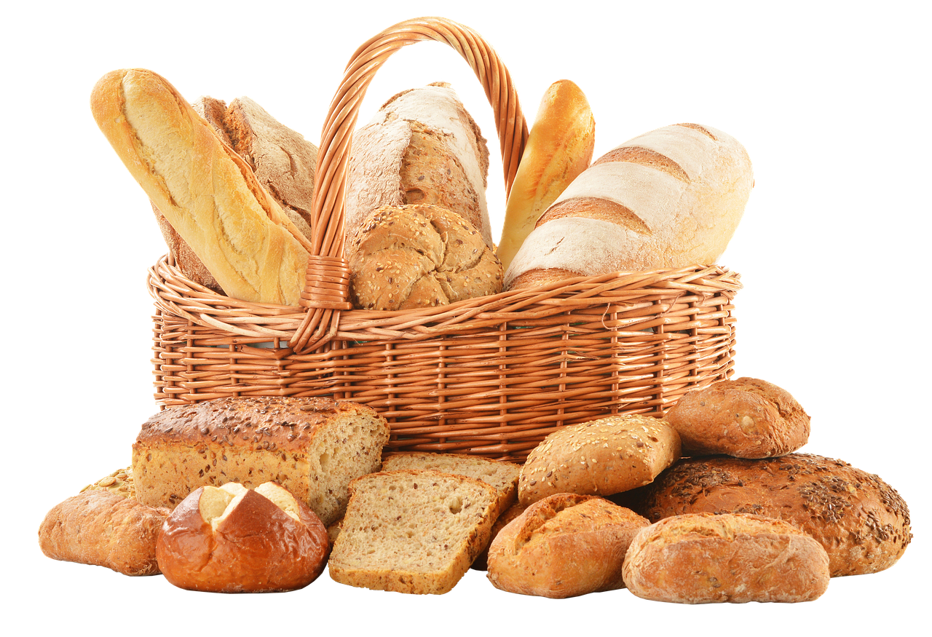

World Food Day Celebration 🌍🍞
Staples of the World
Global Food Research & Cultural Celebration
Thursday, 16th October, 2025

Slide 2
Introduction
World Food Day celebrates food as a universal right.
This programme combines global staple food research with cultural celebration,
highlighting how food connects nations, cultures, and people.

Slide 3
About World Food Day
Observed annually on 16th October.
Raises awareness about hunger, food security, and climate change.
Promotes sustainable agriculture and global unity.

Slide 4
Staples of the World
Staple foods are eaten regularly and provide major energy.
They depend on climate, soil, and culture.
Students researched major staple foods consumed globally.

Slide 5
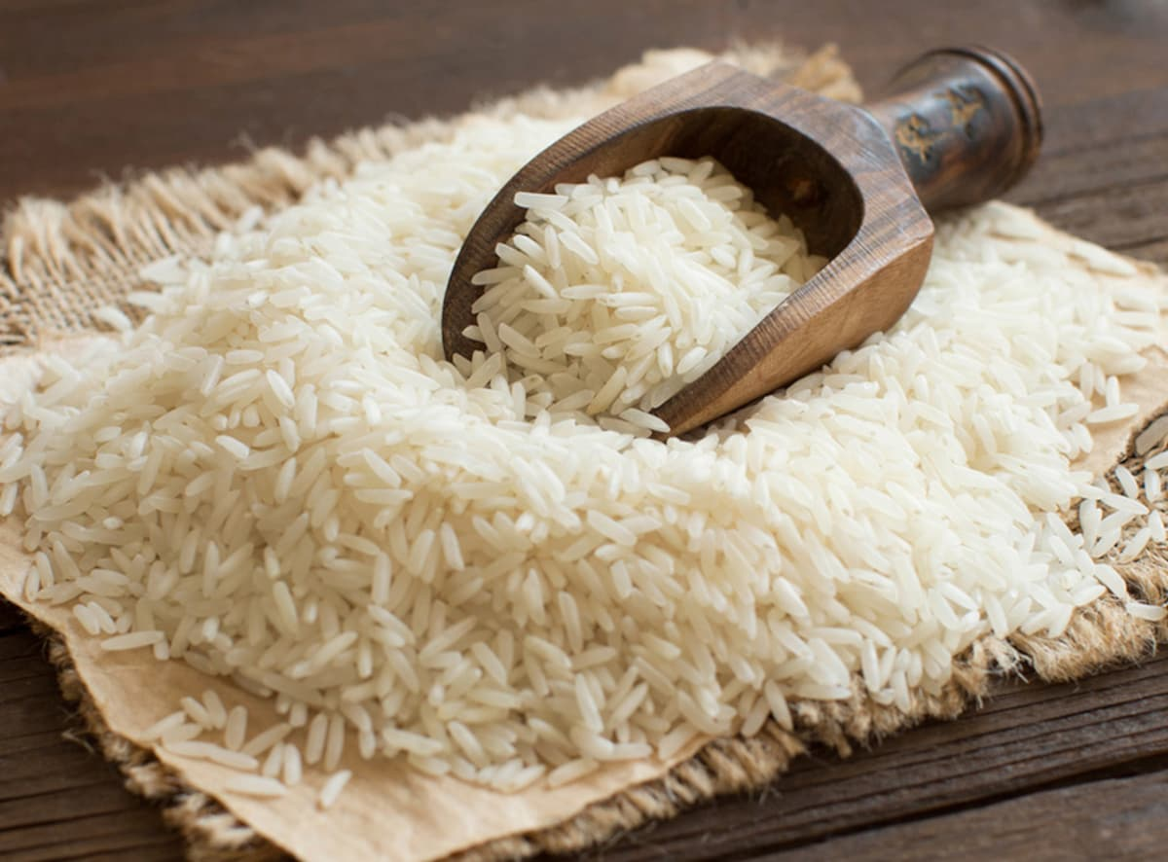
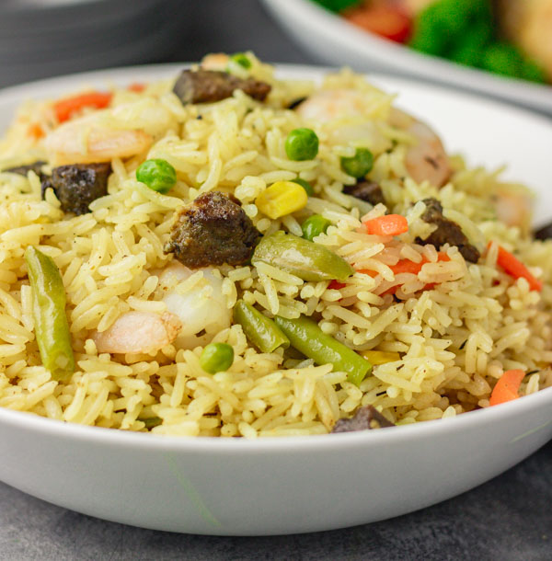
Rice
Consumed widely in Asia and Africa.
A major energy source for over half of the world.

Slide 6
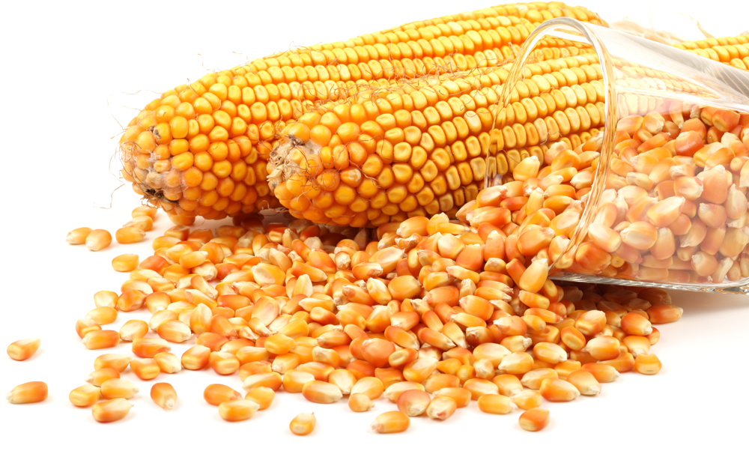
Maize (Corn)
Popular in Africa and the Americas.
Used for food, feed, and industry.

Slide 7
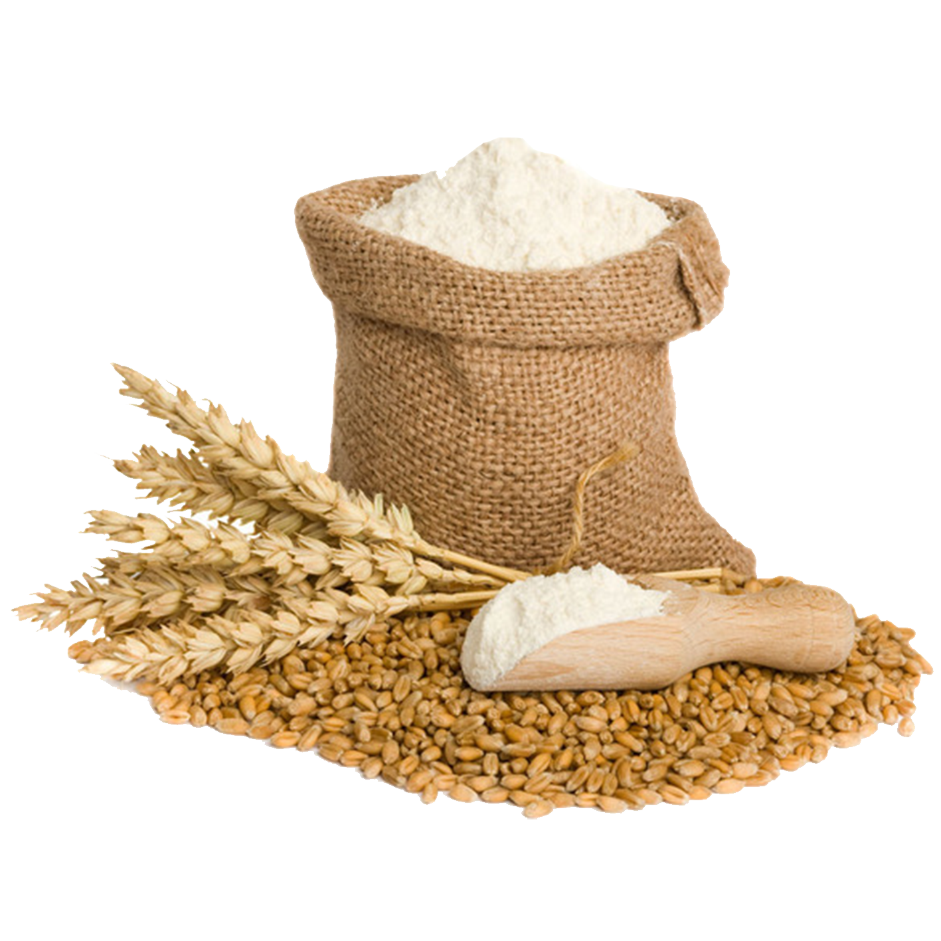
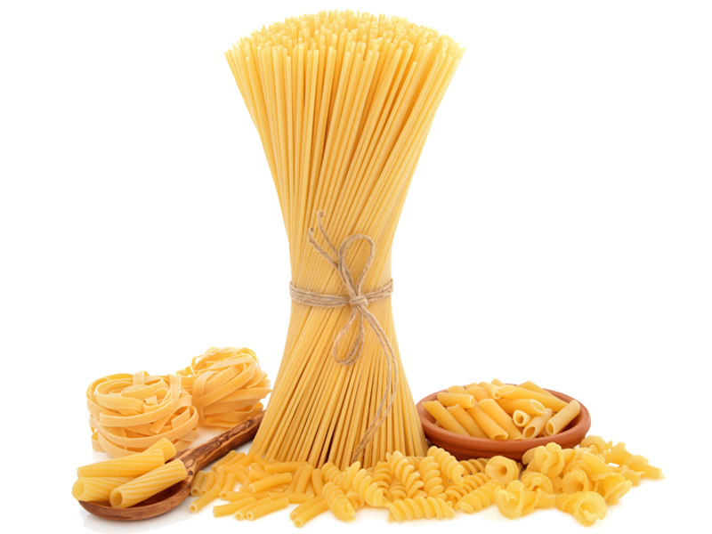
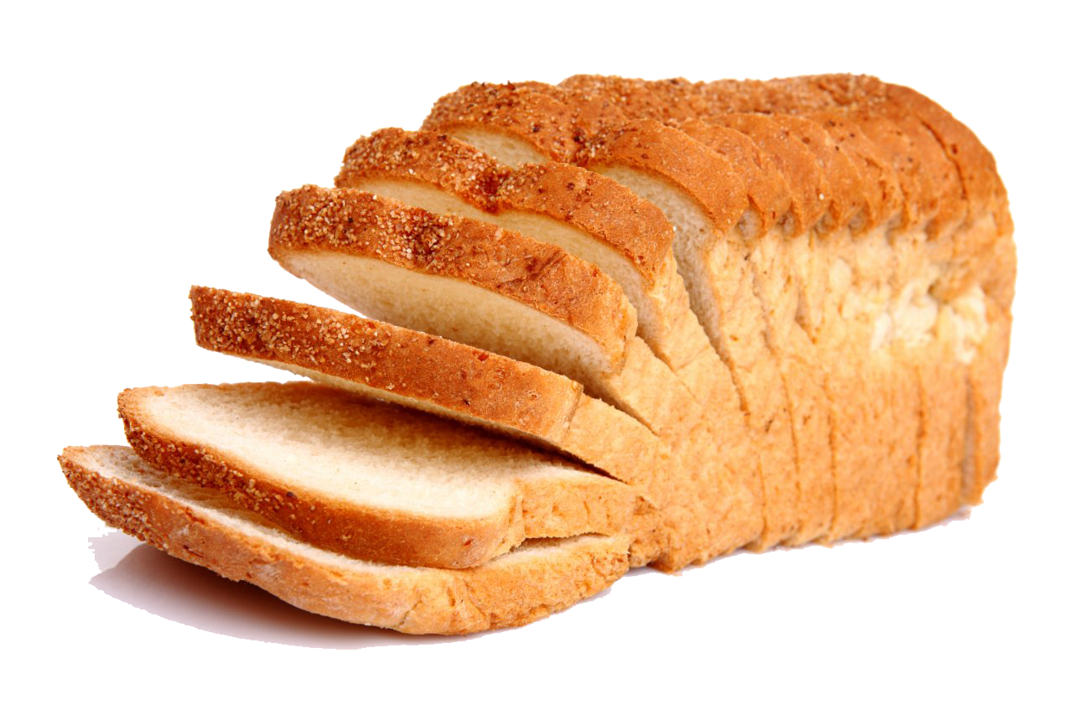
Wheat
Common in Europe, Middle East, and India.
Used for bread, pasta, and pastries.

Slide 8
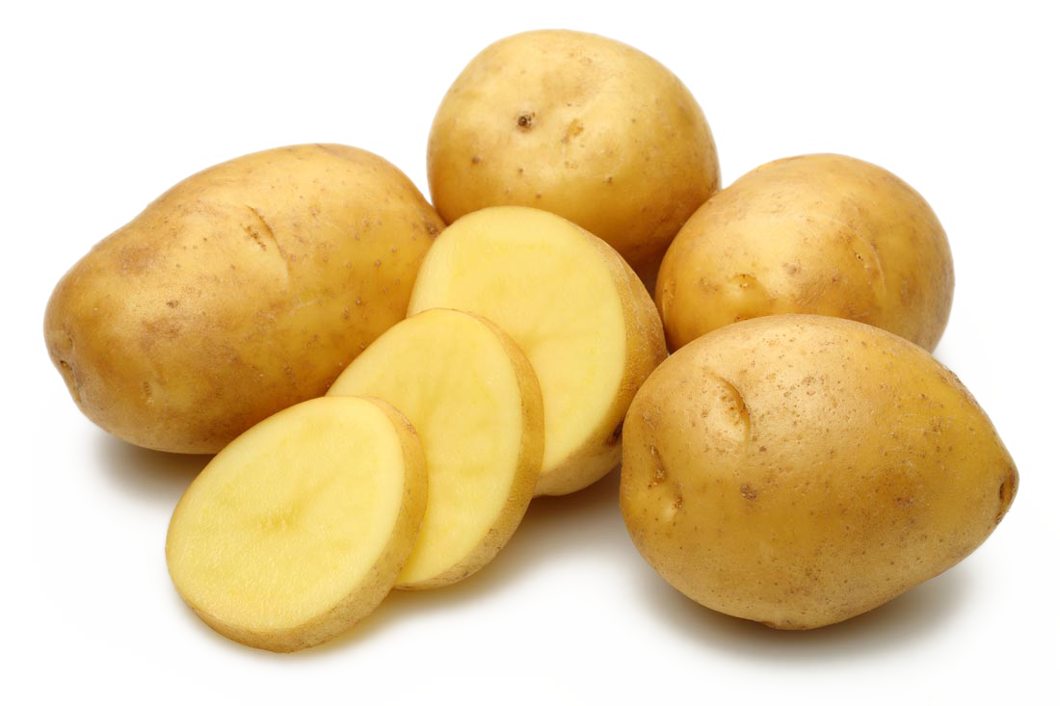
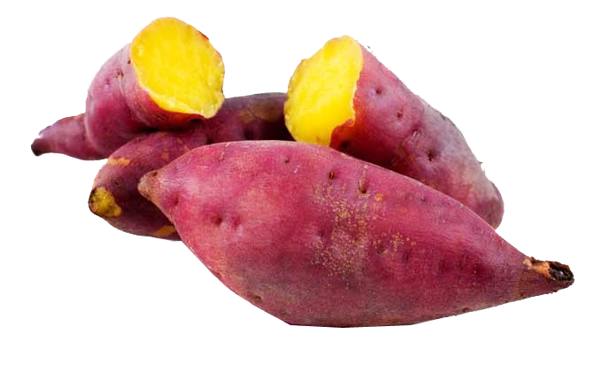
Potatoes
Widely eaten in Europe and America.
Easy to grow and rich in carbohydrates.

Slide 9
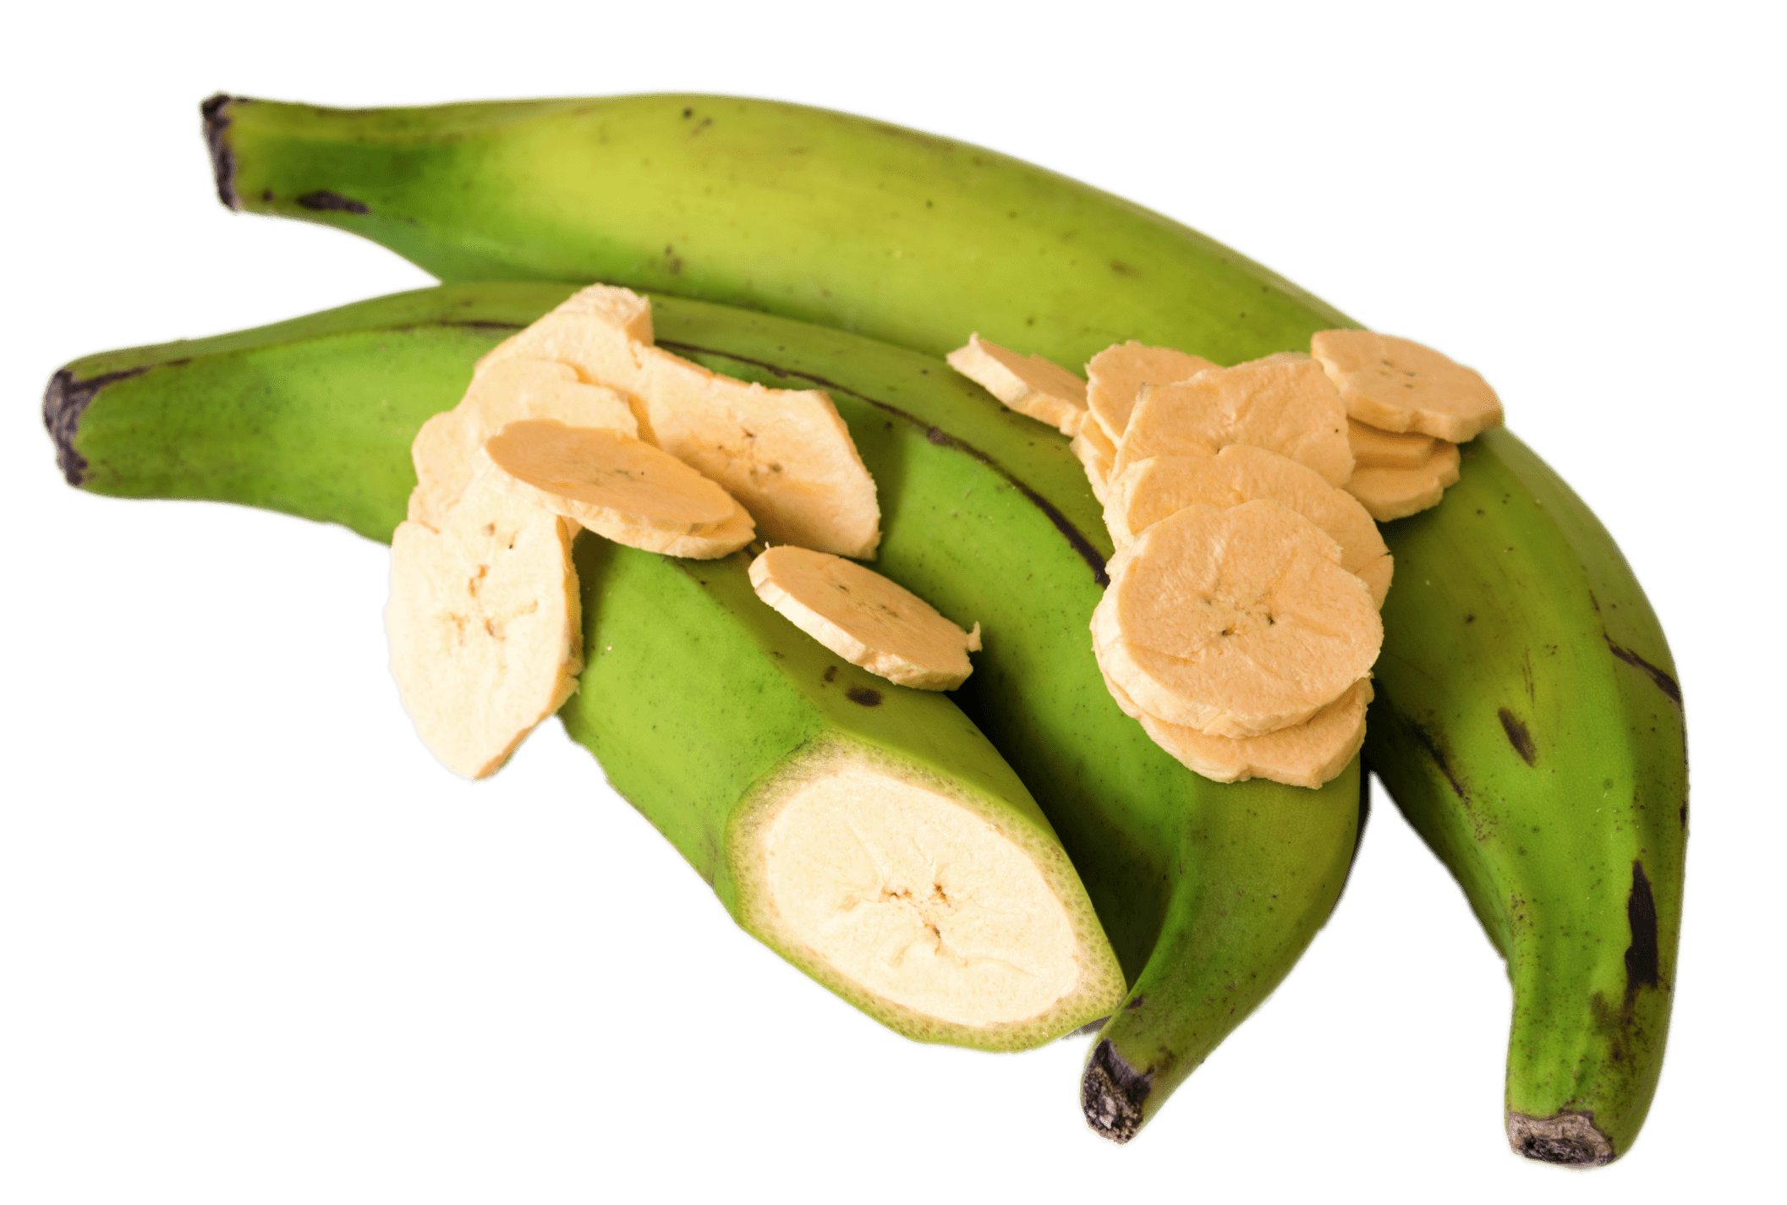
Plantains
Popular in Africa and the Caribbean.
Usually cooked and energy-rich.

Slide 10
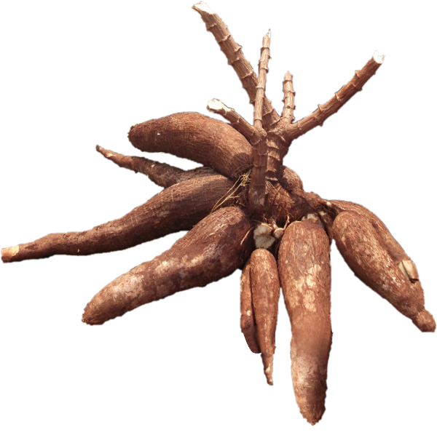
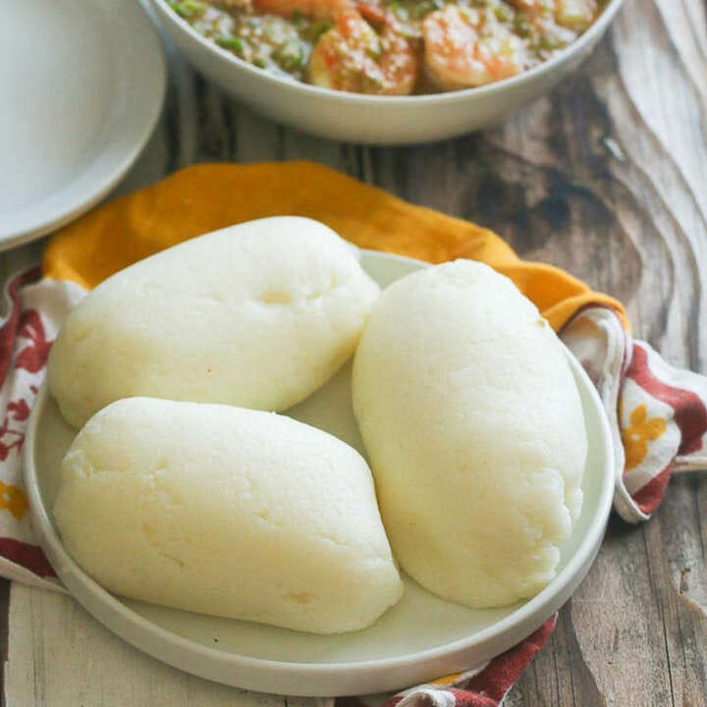
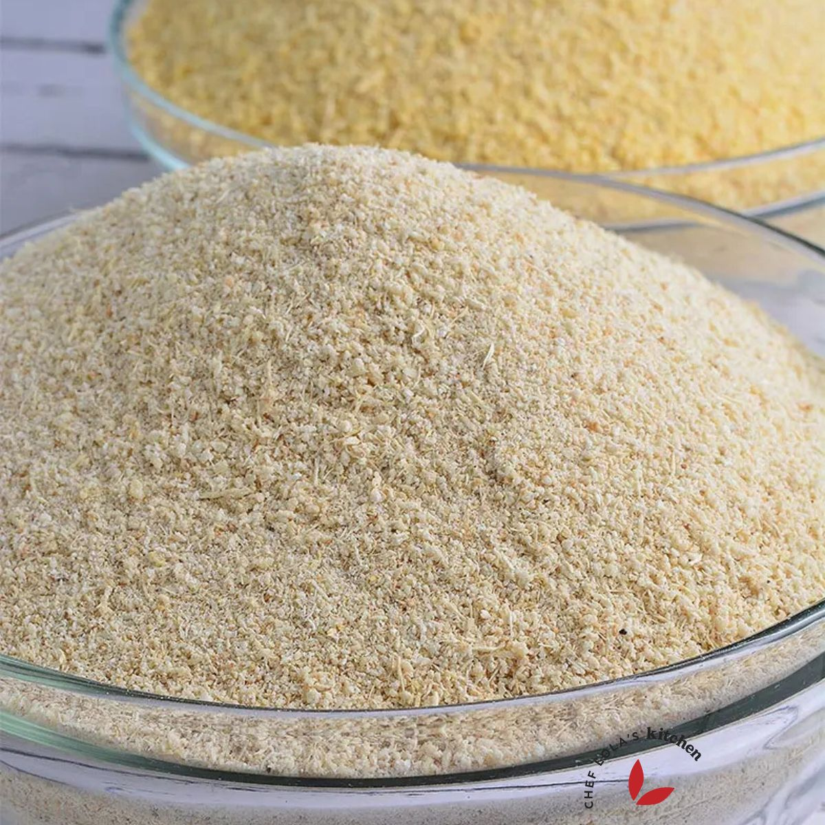

Cassava
A major African staple.
Used to make garri, fufu, and tapioca.

Slide 11
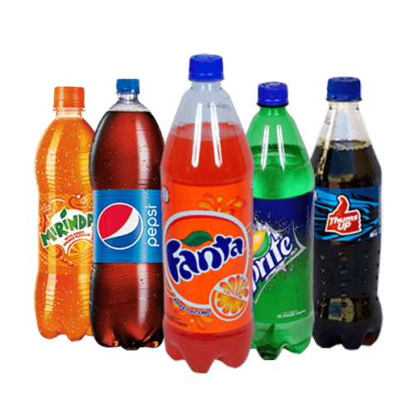
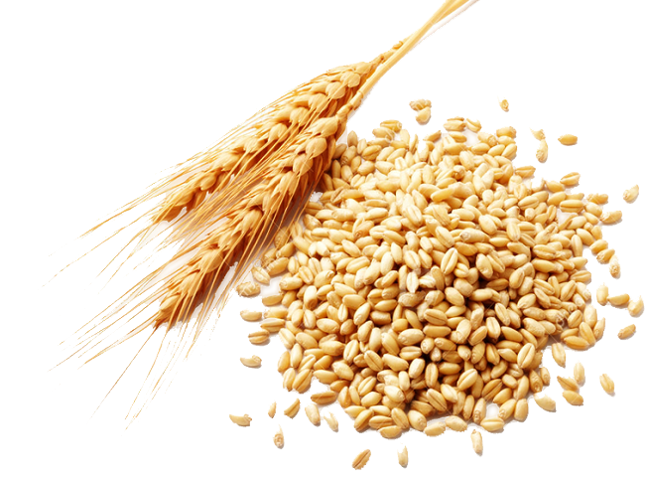
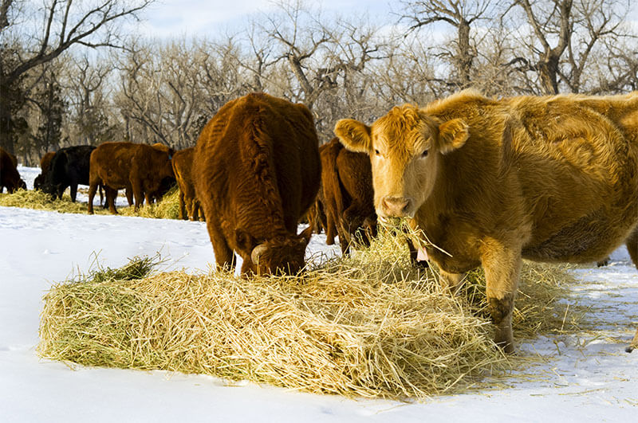
Barley
Grown in cooler regions.
Used for food, animal feed, and beverages.

Slide 12
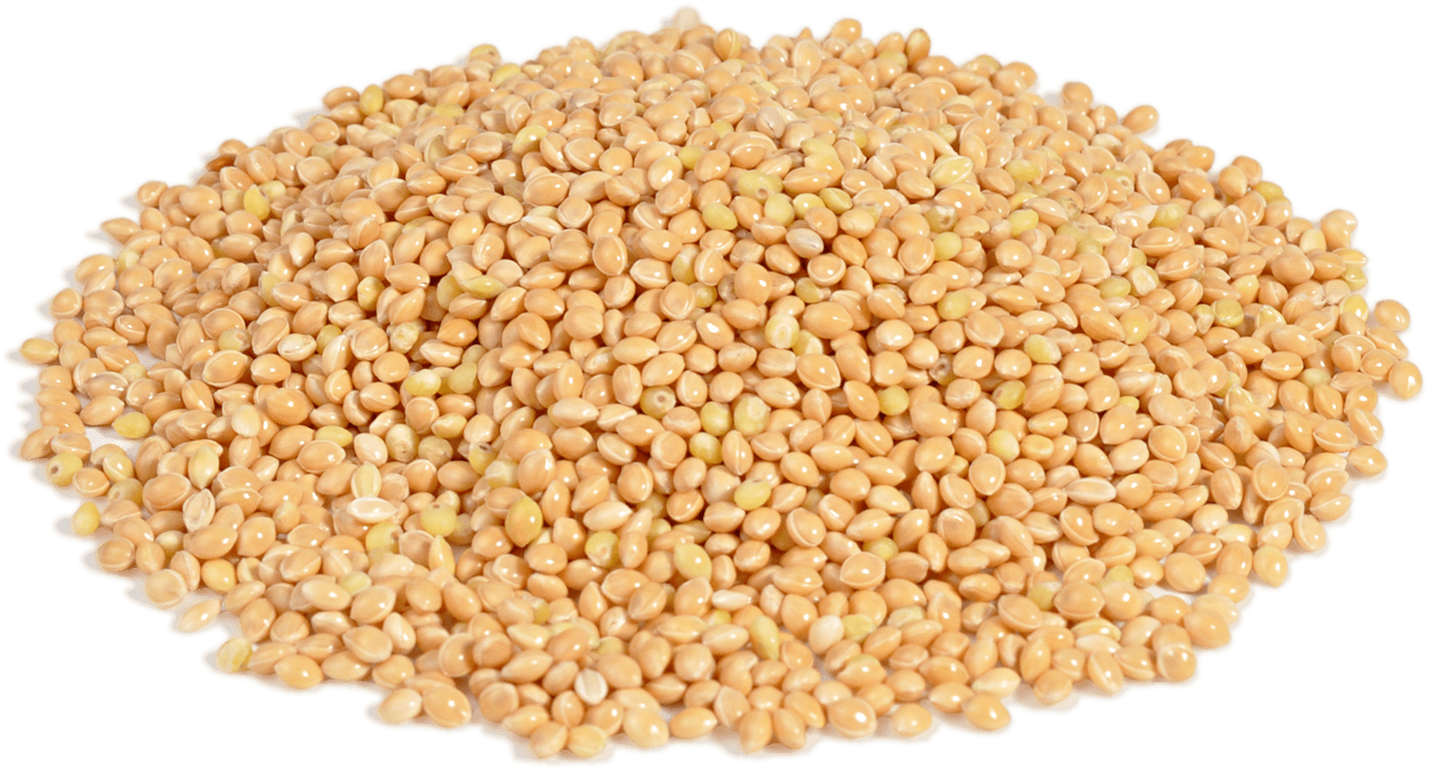
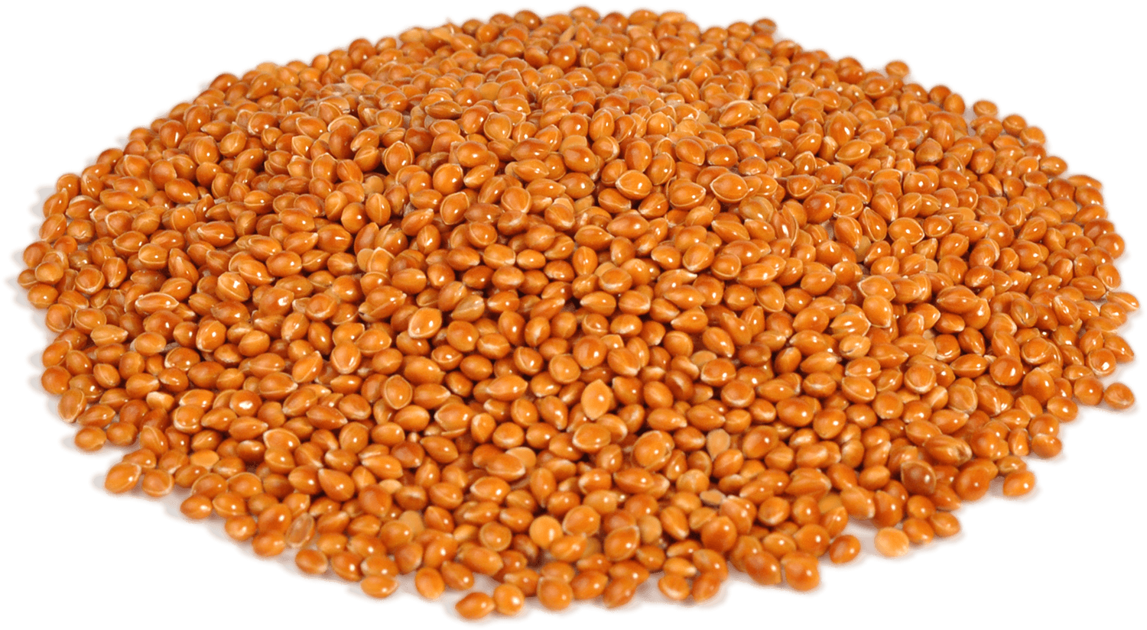
Millet
Common in dry regions.
Nutritious and climate-resilient.

Slide 13
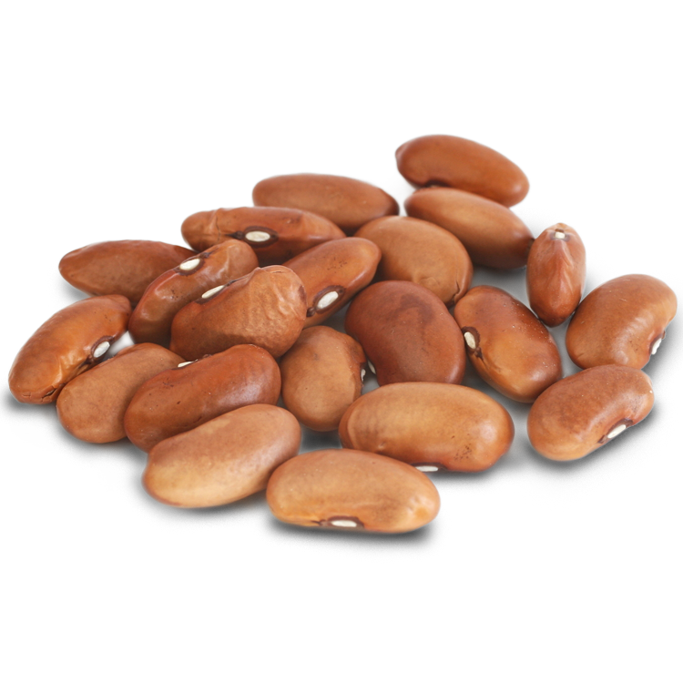
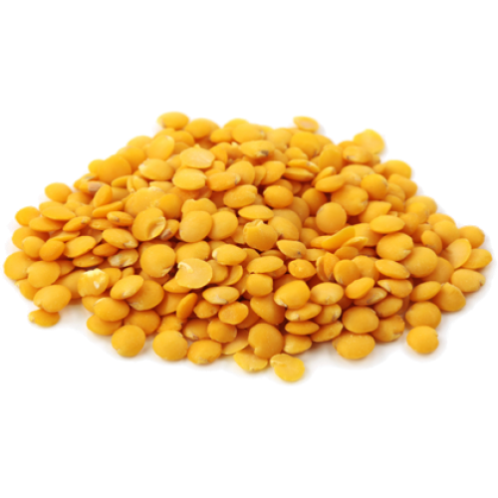
Legumes
Includes beans and lentils.
High in protein and essential nutrients.

Slide 14
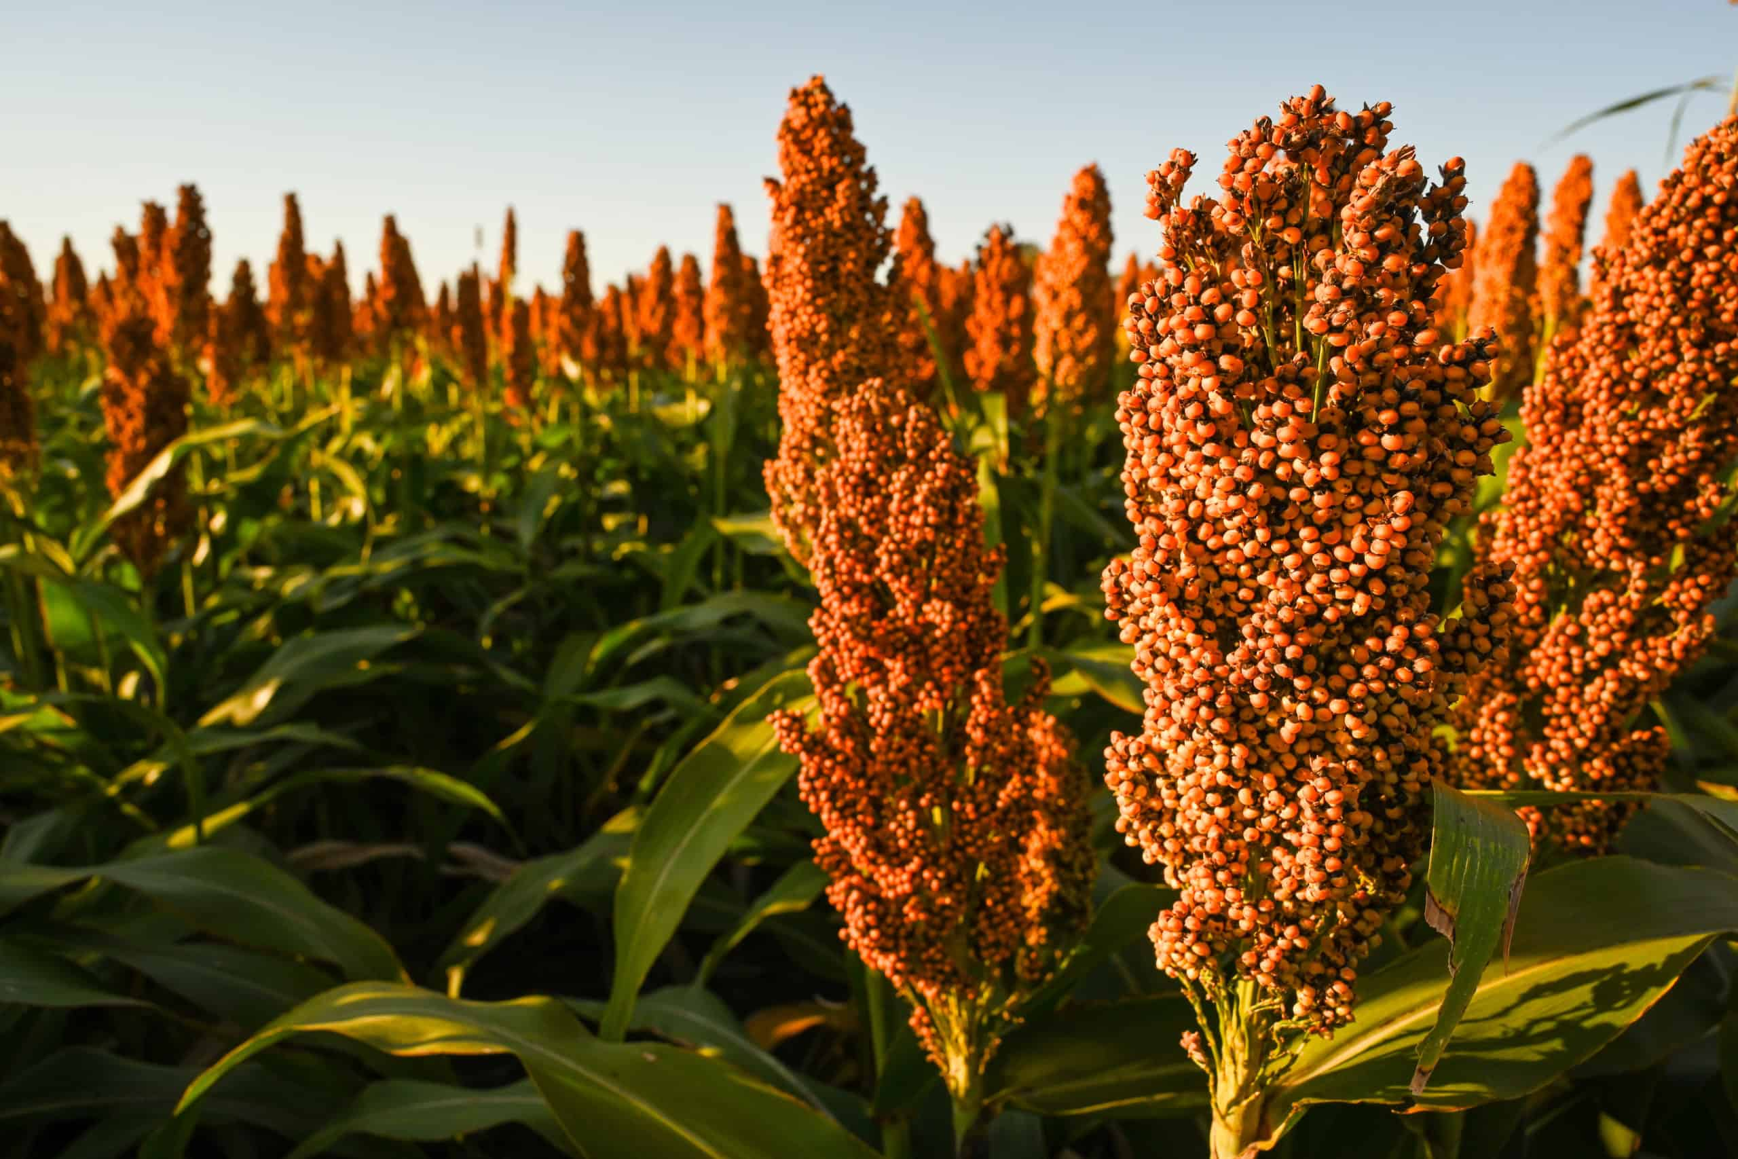
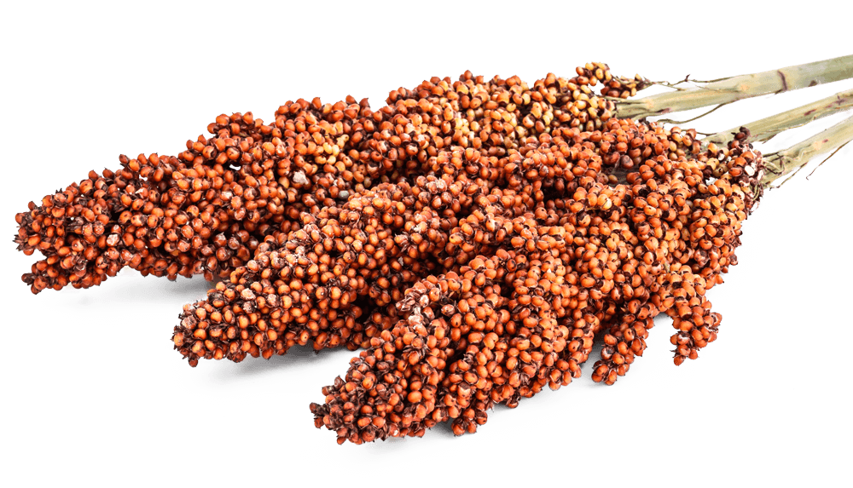
Sorghum
Widely grown in Africa.
Used for porridge and local meals.

Slide 15

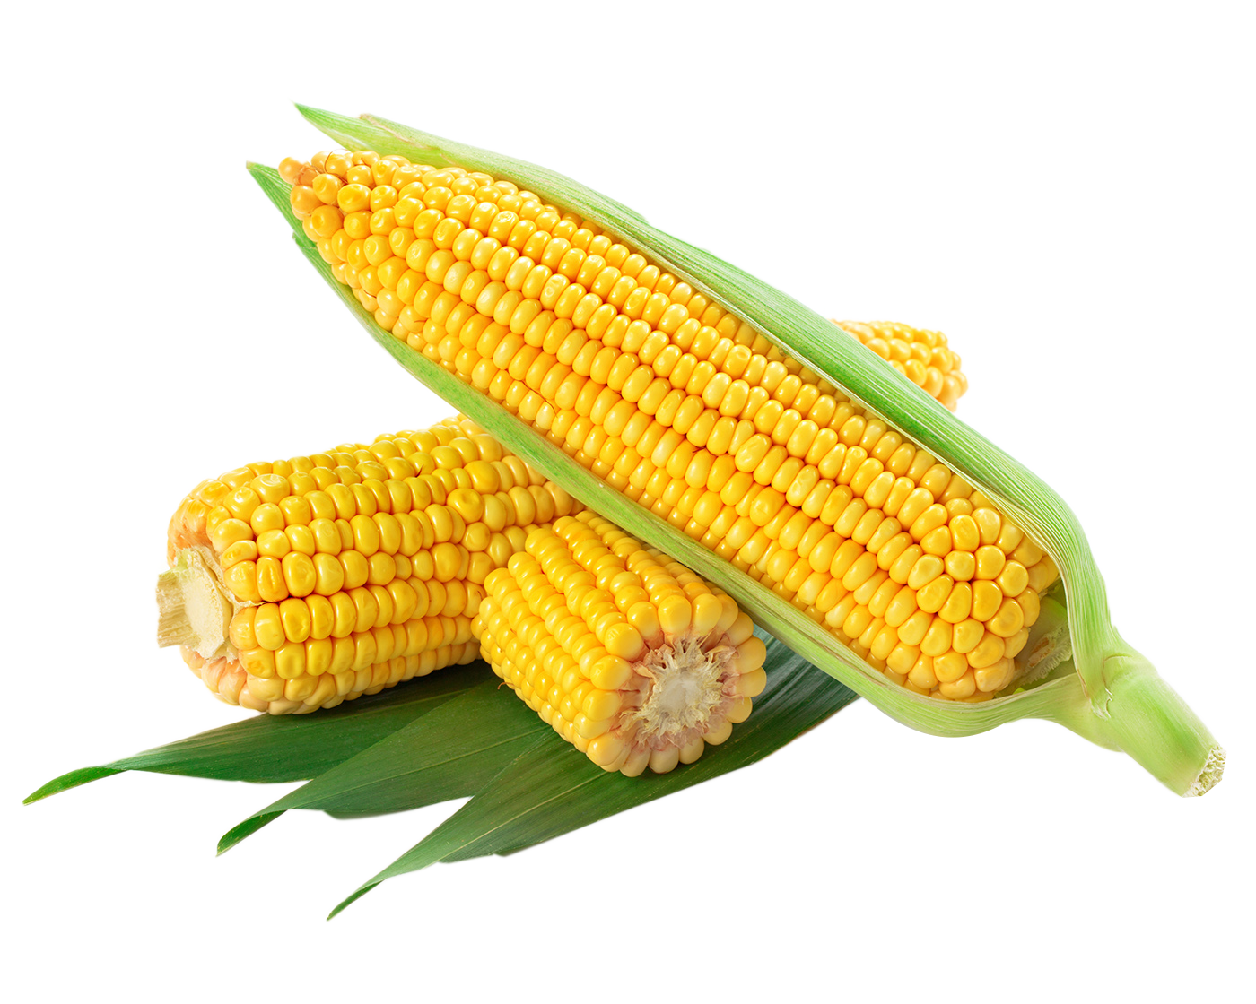
Common Staple Foods of Nigeria
Rice • Cassava • Yam • Maize • Sorghum
These foods reflect Nigeria’s climate and culture.

Slide 16
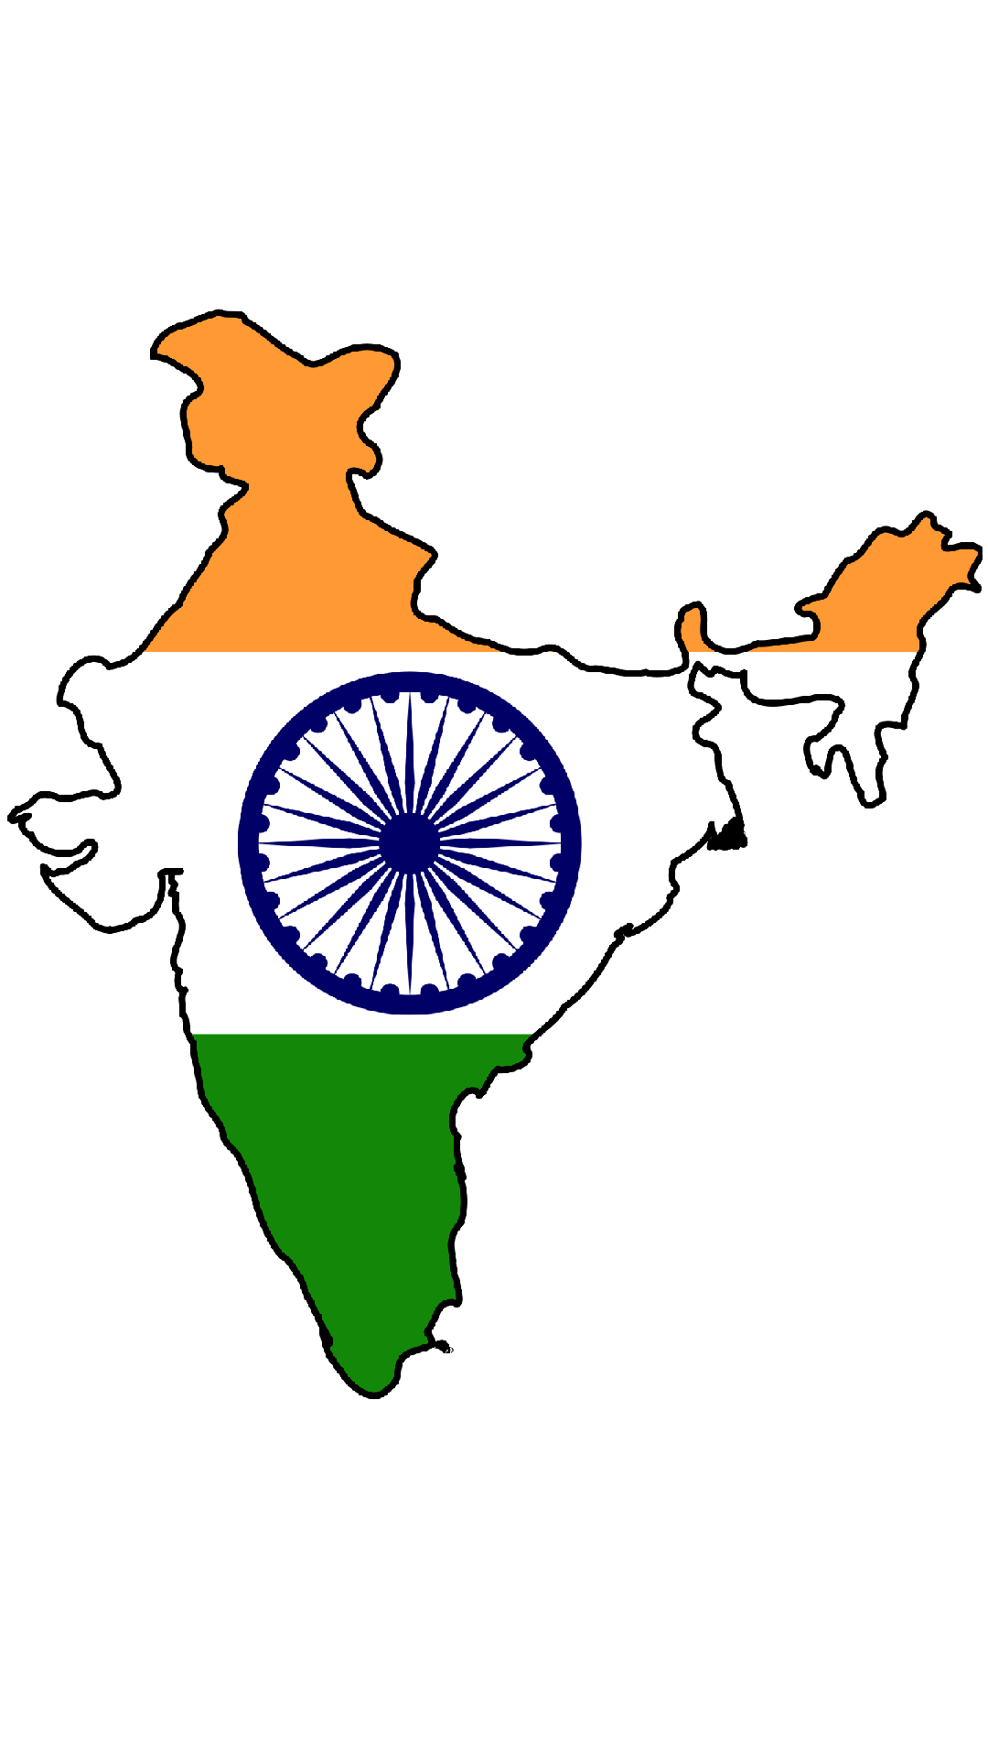
Common Staple Foods of India
Rice • Wheat • Millet • Lentils • Maize
Staples vary across regions due to climate and tradition.

Slide 17

Conclusion
World Food Day reminds us that food connects humanity.
Bread Across Borders celebrates unity through global staple foods.

